Slide 1
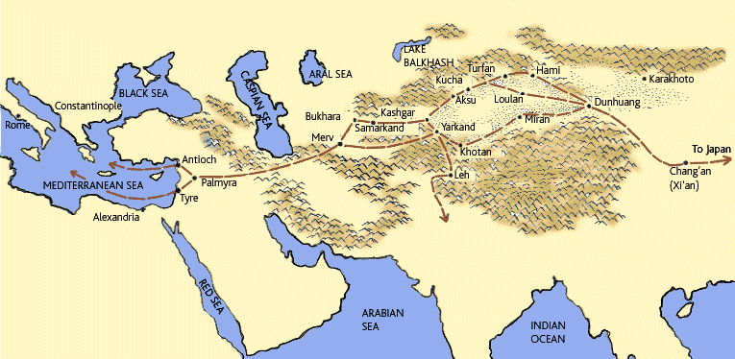
BellRinger #27 5/3/18 See Think Wonder!

Slide 2
Homework
Finish Silk Road Atlas Activity

Slide 3
Table of Contents
Silk Road Notes……....…………………………….pg 12
Silk Road Atlas Activity………………………….pg 13

Slide 4
The Silk Road

Slide 5
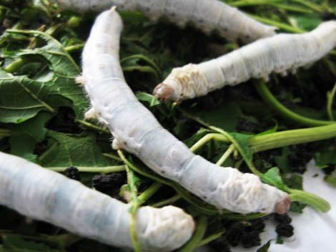
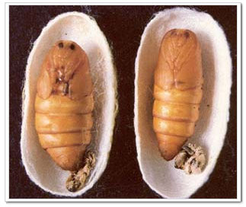
Silk
Lightweight material that is valuable
Chinese first created silk cloth
From Silkworm cocoons

Slide 7
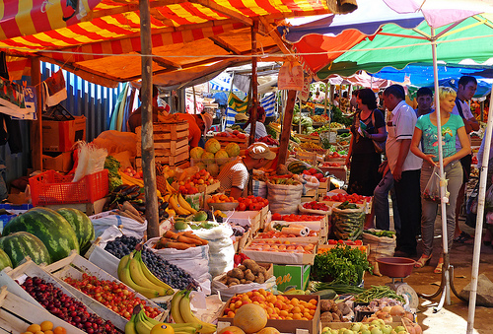
Merchants
Merchants trade goods they have for goods they need
Or goods needed by people in their homeland
Bazaar
Area where most trading happened

Slide 8
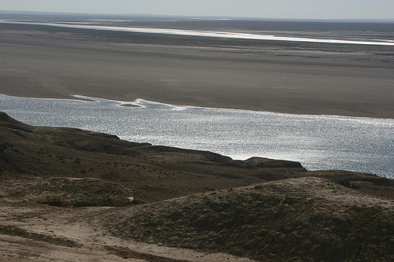
Silk Road
Used by merchants from Europe to Asia
Spain to China
Main path was from Chang’an, China to Tyre, Phoenicia
Very dangerous journey
Mountains, deserts, rivers, bandits

Slide 10
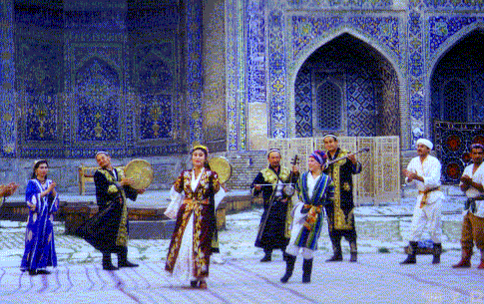
Role of Central Asia
Central Asia became very wealthy
Merchants going either way would leave goods for trade in Central Asia
Central Asian merchants raise the price and sell it to other cultures

Slide 11
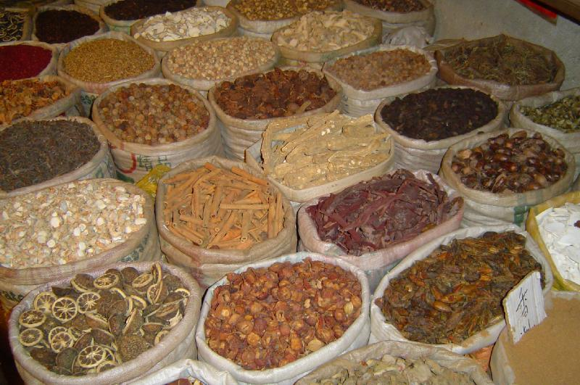
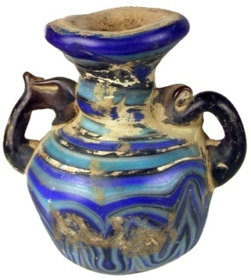
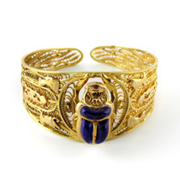
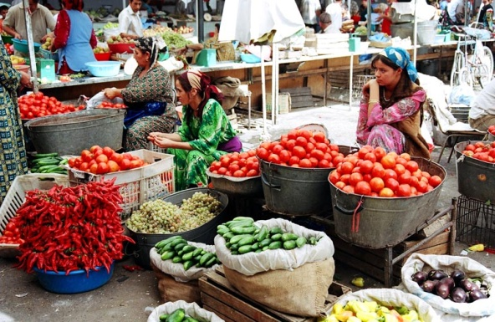
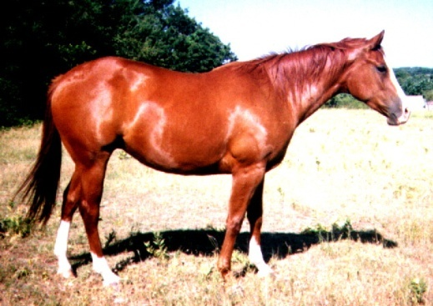
Goods Traded on Silk Road
China
Silk, Spices, Jade, Porcelain
India
Spices, Tea, Cotton, Medicines
Mesopotamia
Wheat, Cattle, Clay pottery, Glass
Egypt
Gold, Silver, Jewelry, Camels
Europe
Gold, Silver, Slaves, Perfumes
Central Asia
Fruits, Horses, Melons

